Slide 1

Module 1: Breastfeeding
In this module, we’ll explore how hormones like prolactin and oxytocin drive lactation, analyze the evidence behind breastfeeding benefits, explore disparities influenced by culture and access, and manage common challenges using real-life cases.
Look for the speaker icon throughout the presentation to hear voiceover on that topic.
by Maggie Hasler

Slide 2
Objectives
1
Describe the roles of prolactin and oxytocin in the physiology of lactation
and explain how hormonal regulation supports milk production and ejection.
2
Compare and contrast the short- and long-term benefits of breastfeeding
for both infants and mothers using evidence-based outcomes.
3
Analyze how cultural beliefs, healthcare systems, and structural inequities
contribute to breastfeeding disparities across populations.
4
Identify common breastfeeding challenges and formulate appropriate
management strategies tailored to the needs of mother-infant dyads.

Slide 3
Composition of Breastmilk
Breastmilk composition changes over time, adapting to the infant's needs. Breastmilk is a rich source of antibodies, providing passive immunity to the infant as well as essential vitamins, minerals, and fats. Breastmilk also contains growth factors that support the infant's development and maturation.
Colostrum
Mature Milk
In the last weeks of pregnancy and first 48-72 hours after delivery colostrum predominates
Transitions around day 10
Colostrum is thick, yellow, and high in protein and relatively lower in fat and glucose compared to mature milk
Colostrum is rich in immunoglobulins

Slide 4

Lactogenesis
Milk "Coming In"
Factors Affecting Timing
Most women typically experience a feeling of "milk coming in" around day 2-5 after delivery. This signifies the onset of mature milk production.
Cesarean deliveries, retained placental fragments, diabetes, and stressful deliveries can delay the onset of mature milk production.

Slide 5

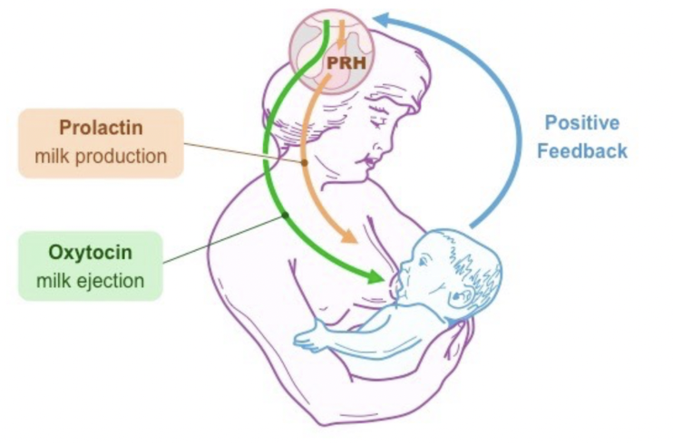
Maintenance of Lactation
Supply and Demand
Frequency of Nursing
Prolactin
Oxytocin
Lactation follows a supply and demand principle. Regular milk removal and nipple stimulation ensure continuous milk production.
Infants typically nurse at least 8 times in a 24-hour period to maintain adequate milk production.
Prolactin stimulates mammary gland ductal growth and epithelial cell proliferation and induces milk protein synthesis.
Infant suckling causes the release of oxytocin. Oxytocin causes contraction of the smooth muscle cells in the mammary glands, leading to milk ejection
Notes:
Pillay J, Davis TJ. Physiology, Lactation. [Updated 2023 Jul 17]. In: StatPearls [Internet]. Treasure Island (FL): StatPearls Publishing; 2025 Jan-. Available from: https://www.ncbi.nlm.nih.gov/books/NBK499981/
Infant and Young Child Feeding: Model Chapter for Textbooks for Medical Students and Allied Health Professionals. Geneva: World Health Organization; 2009. SESSION 2, The physiological basis of breastfeeding. Available from: https://www.ncbi.nlm.nih.gov/books/NBK148970/

Slide 6
What are some benefits to breastfeeding for Mom and baby? Take 30 seconds to think of your answer before moving to the next slide.

Slide 7
Benefits of Breastfeeding: Benefits to Baby
Decreased Risk
Decreased Risk (cont.)
Otitis media
Asthma
Gastroenteritis
Obesity
Necrotizing enterocolitis
Diabetes – Types 1 and 2
Lower respiratory tract infections
Childhood leukemia
Atopic dermatitis/eczema
SIDS

Slide 8
Benefits of Breastfeeding: Benefits to Mom
Decreased Risk
More Benefits
Breast and ovarian cancer
Cost savings (not accounting for mother's time)
Endometrial cancer
Uterine involution/ blood loss after delivery
Thyroid cancer
Eco-friendly
Type 2 Diabetes
Hypertension

Slide 9


Contraindications to Breastfeeding
Contraindications
Contraindications (cont)
HIV with detectable viral load
Certain medications (optional video)
HTLV I or II
Ebola
Drugs of abuse
Active brucellosis
Active HSV - not on infected side
Tuberculosis and varicella
  Mom contagious but milk okay to give

Slide 10

Initiation of Breastfeeding
Initiating breastfeeding as soon as possible after birth is crucial. The first few hours and days are critical for establishing a successful breastfeeding relationship.

Slide 11

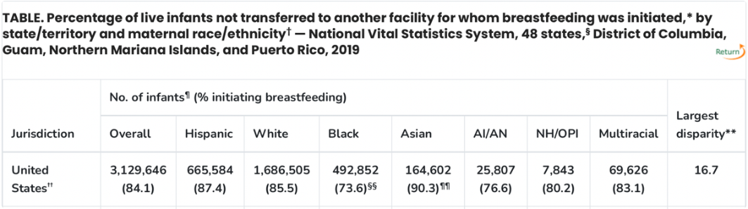
Current Initiation Rates
While breastfeeding is a fundamental aspect of infant health, initiation rates vary across ethnic groups. It's crucial to address disparities and encourage informed breastfeeding practices among all mothers.
Breastfeeding is a major determinant of infant short- and long-term health, preventing acute infections and programming lower risk for chronic disease
Notes:
https://www.cdc.gov/mmwr/volumes/70/wr/mm7021a1.htm
Marks KJ, Nakayama JY, Chiang KV, Grap ME, Anstey EH, Boundy EO, Hamner HC, Li R. Disaggregation of Breastfeeding Initiation Rates by Race and Ethnicity - United States, 2020-2021. Prev Chronic Dis. 2023 Dec 14;20:E114. doi: 10.5888/pcd20.230199. PMID: 38096123; PMCID: PMC10723082.
Chiang KV, Li R, Anstey EH, Perrine CG. Racial and Ethnic Disparities in Breastfeeding Initiation ─ United States, 2019. MMWR Morb Mortal Wkly Rep. 2021 May 28;70(21):769-774. doi: 10.15585/mmwr.mm7021a1. PMID: 34043611; PMCID: PMC8158892.
Geddes DT, Gridneva Z, Perrella SL, Mitoulas LR, Kent JC, Stinson LF, Lai CT, Sakalidis V, Twigger AJ, Hartmann PE. 25 Years of Research in Human Lactation: From Discovery to Translation. Nutrients. 2021 Aug 31;13(9):3071. doi: 10.3390/nu13093071. PMID: 34578947; PMCID: PMC8465002.

Slide 12
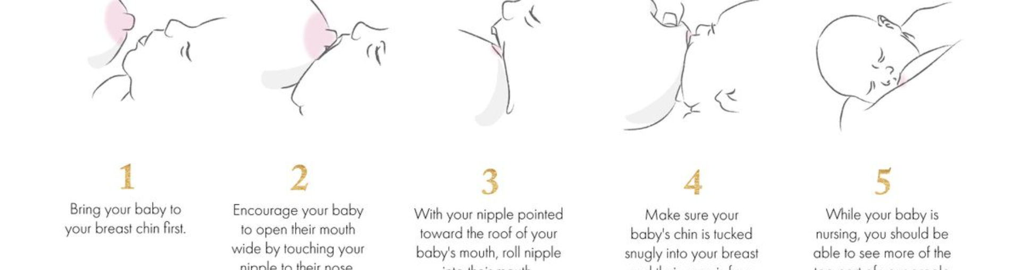
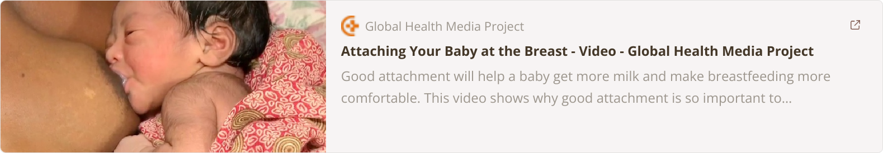
Ensuring an Effective Latch
An effective latch is crucial for successful breastfeeding. A good latch ensures adequate milk removal and maintenance of
supply and helps prevent nipple trauma
Watch this optional video to learn how to help nursing dyads ensure a proper latch

Slide 13
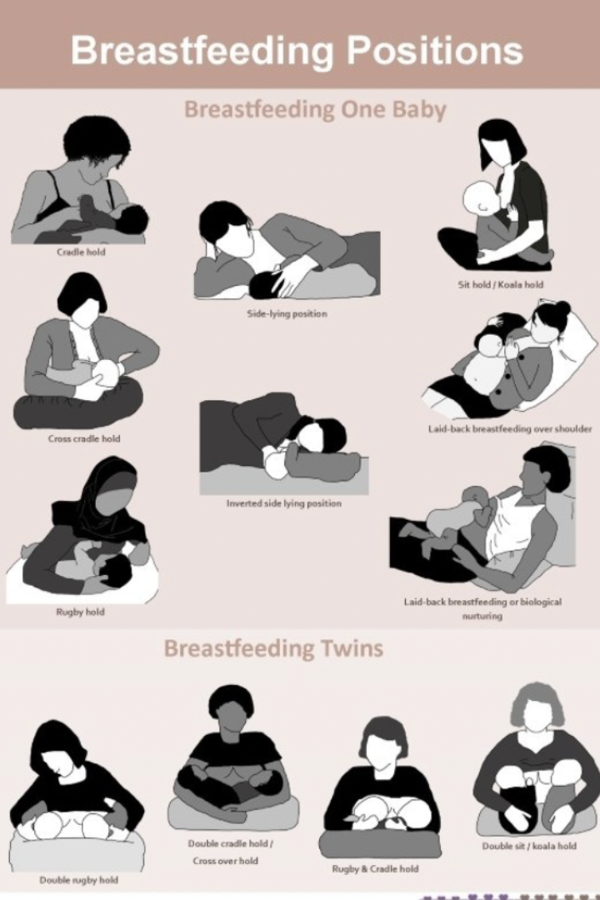

Breastfeeding Positions
Finding the right breastfeeding position is essential for both mother and baby's comfort and success. This video explores various positions and their benefits.

Slide 14

Signs of a Good Latch
Comfort
Positioning
The latch should be comfortable and pain-free for both the mother and baby.
Baby's chest and stomach rest against the mother's body, with the head straight, not turned.
Chin and Mouth
Lips and Tongue
The baby's chin should touch the breast, and the mouth should open wide, encompassing more than just the nipple.
The baby's lips should be turned outward, and the tongue should cup underneath the breast, creating a seal.

Slide 15


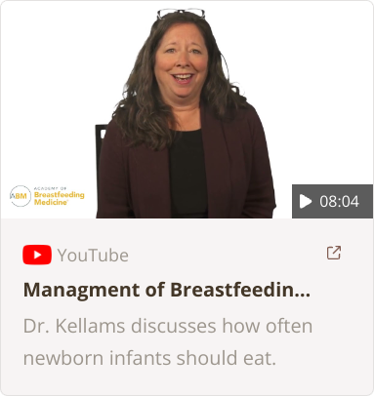
Breastfeeding Frequency
On Demand
Hunger Cues
General Frequency
Infants should feed whenever they show signs of hunger, such as rooting, sucking, or making noises.
Babies typically feed 8-12 times in a 24-hour period. (Optional video discussing breastfeeding frequency)

Slide 16
What are some signs that an infant is getting enough milk? Take 30 seconds to think of your answer before moving to the next slide.

Slide 17






Signs of a Well-Fed Infant
Feeding Frequency
Wet Diapers
At least 8 feedings in 24 hours.
At least 1 wet diaper per day of age until day 6
Skin and Membranes
Weight Gain
Moist mucous membranes and appropriate skin turgor
Weight should follow the expected curve for delivery and feeding type (NEWT).

Slide 18
Breastfeeding Disparities
Racial and Ethnic Disparities:
Socioeconomic Factors:
Hospital Practices and Policies:
Studies highlight that Non-Hispanic Black mothers consistently have lower breastfeeding initiation and duration rates compared to Non-Hispanic White and Hispanic mothers.
Lower-income families often experience reduced access to lactation resources, such as certified lactation consultants or breastfeeding education programs, and are more likely to encounter formula-promotion practices in healthcare settings.
Research shows that hospitals serving higher proportions of minority and low-income populations are less likely to implement evidence-based breastfeeding support practices, such as early skin-to-skin contact or rooming-in policies.
Non-Hispanic Black mothers face unique structural barriers, including limited access to breastfeeding support, workplace accommodations, and fewer hospitals with Baby-Friendly practices.
Mistrust of healthcare systems, cultural beliefs, and historical inequities, particularly among Black communities, also contribute to disparities.
Access to healthcare, paid leave, and childcare influence breastfeeding success.

Slide 19
Addressing Breastfeeding Disparities
Strategies to reduce breastfeeding disparities include:
Expanding access to lactation support in underserved communities
Utilizing peer counseling and community health workers
Promoting Baby-Friendly hospital practices
Providing adequate, paid maternity leave
Provide workplace accommodations to support breastfeeding
Addressing structural inequities through policy changes
Reducing breastfeeding disparities is essential for improving maternal and infant health outcomes, particularly in communities disproportionately impacted by structural barriers and inequities.

Slide 20
Additional Cultural Considerations
Many of the world’s infants are given liquids other than mother’s milk in the first few days after birth, including those who eventually are breastfed exclusively, stemming from concerns about the nutritional value of and the cultural taboos against colostrum.
Some groups believe that feeding sugared water, honey, teas, sweet oils, or butter “cleanses” the newborn’s gut by promoting the elimination of meconium, which is believed to be harmful.
Prelacteal fluids fed in some traditional societies are described here in Table 1.
  Infants in Durango, Mexico, have been reported to be fed an infusion of sugar water mixed with herbs 30 minutes after birth because mothers believe their milk is too strong for the baby.
  In Vietnam, colostrum often is viewed to be “old milk” and discarded, and infants are fed either ginseng herbal-root tea or boiled sugar water for the first 2 to 3 postnatal days.
  In several African countries, common water-based prelacteal feedings given to infants in the first 3 postnatal days include sugar water, water, salty liquids, and teas as well as milk, porridge, and honey
Notes:
https://ethnomed.org/clinical_topic/pediatrics/?audience=providers

Slide 21
Common Breastfeeding Challenges

Slide 22



Milk Supply
Steady Supply
1
A normal supply is 24-30 ounces in 24 hours (or 1-1.2 oz/ hour)
Consistent
2
Supply typically remains steady from months 1-9.
Solid Foods
3
From month 9 onwards, solid foods take priority over breast milk.

Slide 23


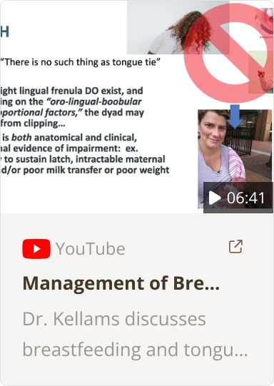
Tongue Tie
1
AAP Statement
2
Academy of Breastfeeding Medicine

Slide 24
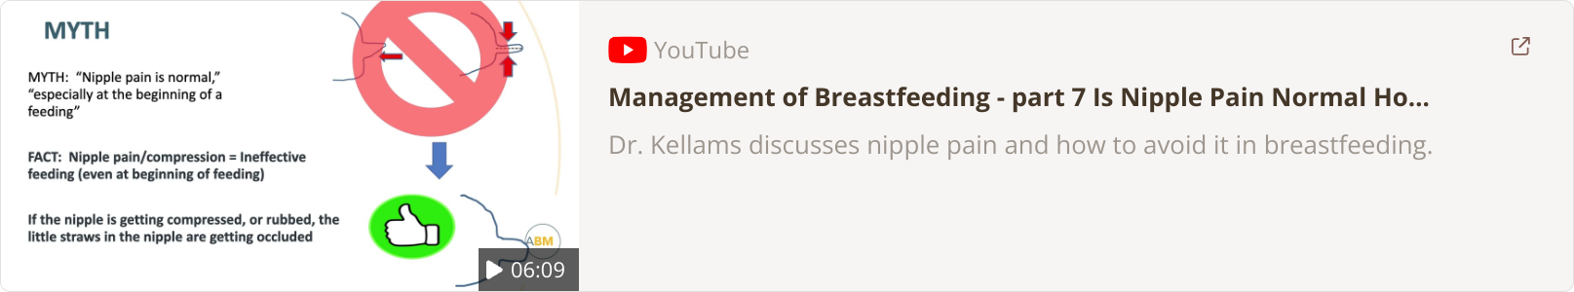
Nipple Pain
1
Latch Issues:
2
Nipple Shield:
This is the most common reason for pain. Ensure a
deep latch and encourage different breastfeeding
positions to mitigate pressure points.
Consider a nipple shield as temporary relief. This can
make breastfeeding easier for women with flat or
Inverted nipples,
3
Academy of Breastfeeding Medicine Recommendations
To promote healing:
Apply lanolin or other hypoallergenic nipple balm; breast milk also has natural healing properties and can be used
Hydrogel pads can soothe cracked, irritated skin
Ensure pump settings are not too high, or limit pumping during healing

Slide 25
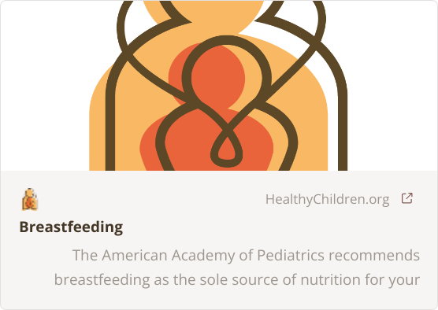
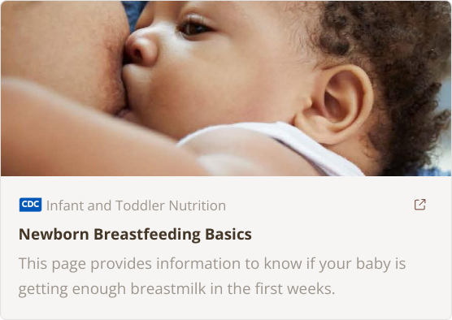
Additional Resources
AAP Breastfeeding Resources
1
2
CDC Breastfeeding Basics
La Leche League: Home
3
Notes:
ADD AAP Breastfeeding Modules

Slide 26
Case
Maria, a 32-year-old mother, presents with her 2-week-old infant, Lucas, to your pediatric clinic. Lucas was born at term via an uncomplicated vaginal delivery and has been exclusively breastfed since birth. Maria is concerned because Lucas has not regained his birth weight and seems to be crying more frequently.
Birth weight: 3.6 kg
Current weight: 3.45 kg
Maria mentions that breastfeeding has been challenging. She reports the following:
• Lucas latches for 10-15 minutes but often falls asleep at the breast.
• She has experienced nipple pain and sometimes sees cracks or bleeding.
• She’s unsure if Lucas is getting enough milk because her breasts don’t feel “full” anymore.
Link to case HERE

Slide 27
Additional Resources

Slide 28


Academy of Breastfeeding Medicine: Anatomy and Physiology of Lactation
This video reviews the anatomy and physiology of lactation.

Slide 29

Academy of Breastfeeding Medicine: Risks of Not Breastfeeding
The Academy of Breastfeeding Medicine (ABM) reviews benefits of breastfeeding for mom and baby.

Slide 30


Academy of Breastfeeding Medicine
The Academy of Breastfeeding Medicine provides valuable resources on breastfeeding techniques and baby cues. Watch these videos to learn how babies learn to breastfeed effectively.

