Slide 1
Sleep, Fatigue Mitigation and Burnout
Subodh Arora, MD, FAAP
Capt, USAF, MC
Pediatrics, Sleep Medicine

Slide 2
Disclaimer
All views are those of my own and do not represent DOD, DHA, USAF, US Army, US Navy, Coast Guard

Slide 3
Objectives
Give you time to reflect on your sleep habits, sleepiness and fatigue
Give you time to reflect on what makes you recover
Give you some tools to help mitigate aspects of residency towards your well being
Check the ACGME box

Slide 4
Sleep Requirements
Notes:
Recommended sleep duration is 7-9 hours for most people. Very few people (<2.5%) can function optimally despite getting less than that

Slide 6
Assess your sleepiness
Perform the Epworth Sleepiness Scale
Respond to question 1 in your Fatigue Action Plan
https://www.polleverywhere.com/free_text_polls/9k51oPU22kbxE03xvFPcy
Notes:
https://www.polleverywhere.com/free_text_polls/9k51oPU22kbxE03xvFPcy

Slide 7
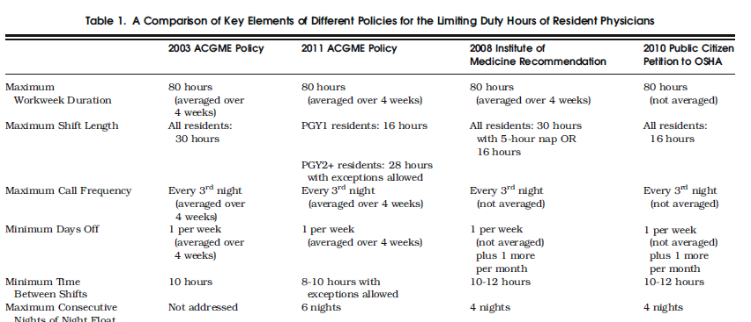
Notes:
Accreditation Council for Graduate Medical Education. Resident Duty
Hours in the Learning and Working Environment: Comparison of 2003 and 2011 Standards. 2010; http://www.acgme.org/acwebsite/dutyhours/dh-ComparisonTable2003v2011.pdf. Accessed May 27, 2011.

Slide 8
Resultant Physician Safety and Health
Following implementation 2011 ACGME work-hour limit:
Extended duration (≥24-h) shifts/month: 3.9 → 0.2.
Risk of motor vehicle crash 24%
Percutaneous injury risk 40%
Rate of attentional failures reduced 18%
Notes:
Study re: first year interns
All medical students matched to a US residency program from 2002 to 2007 and 2014 to 2017 were invited to participate in prospective cohort studies

Slide 9
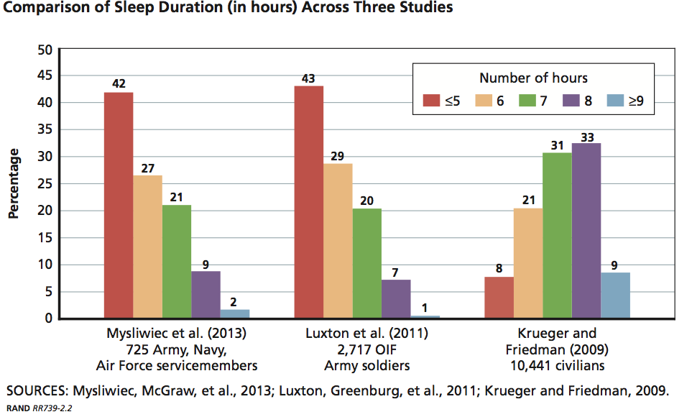
Military and Sleep
Notes:
Approximately 75% of military members across several studies get less than 7 hrs of sleep, much less than our civilian counterparts

Slide 10
Consequences of Insufficient Sleep
IMMEDIATE EFFECTS
(MOST CRITICAL):
Impaired operational readiness:
Impaired mental effectiveness
Impaired alertness
Effects are IMMEDIATE (seen after 1 night of insufficient sleep)
Effects are INSIDIOUS (person may feel fine)
DAILY / MID-TERM EFFECTS:
Overall mood and sense of well-being
Ability to work with and resolve conflicts with co-workers, family members
Motivation to stick to PT regimen
Motivation to stick to healthy diet
Job productivity
MID/LONG-TERM ASSOCIATIONS:
Increased risk for developing behavioral health problems (combat operational stress disorder, PTSD)
Increased risk for weight gain, Type II diabetes, heart disease, etc.
Notes:
Note, in the past, many physicians were known, if not legend for their temperament
Nurses doing night shift consistently are at higher risk of breast cancer

Slide 11
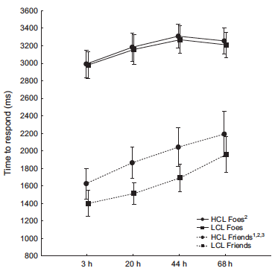
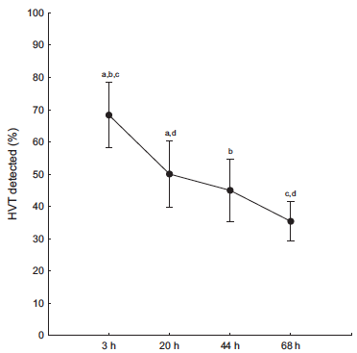
N= 20 Soldiers
72 hour test period
2 hours of sleep per night
Friend-versus-Foe Challenge
Increasing Complexity
Marksmanship
Discrimination
Cognitive load
Notes:
Smith et al (2017) examined the effects of sleep loss over 72-hours on a simulated marksmanship task. Results showed that the ability to correctly discriminate between friend and foe targets significantly decreased in the high-cognitive-load condition over time despite shot accuracy remaining stable, and that despite decrements in performance, participants believed their performance did not change over time.
The NASA-Task Load Index revealed that, although marksmanship performance degraded, participants believed their performance did not change over time. These results further characterize the consequences of sleep restriction on marksmanship performance and the perception of performance, and reinforce the importance of adequate sleep among service members when feasible.

Slide 12
Effects of Sleep on Medical Interns
Notes:
Kalmbach et al, 2017 Sleep Disturbance, Short Sleep:
Survey data from 1215 nondepressed interns collected at preinternship baseline, then 3, 6 months into internship.
Examined how preinternship sleep quality, internship sleep, work hours affected risk of depression at 3 months, per the Patient Health Questionnaire 9.
Examined the impact of sleep loss and work hours on depression persistence from 3 to 6 months.
Compared self-reported errors among interns based on nightly sleep duration (≤6 hr vs. >6 hr), weekly work hours (<70 hr vs. ≥70 hr), and depression (non- vs. acutely vs. chronically depressed).
Sleep disturbance and internship-enforced short sleep increase risk of depression development (133%) and chronicity and medical errors (27%)
Effects of Sleep, Physical Activity (Kalmbach et al): After beginning residency, interns lost an average of 2 h and 48 min of sleep per week (t = - 3.04, p < .01). Mood and physical activity decreased by 7.5% (t = - 3.67, p < .01) and 11.5% (t = - 3.15, p < .01), respectively. A bidirectional relationship emerged between sleep and mood during internship wherein short sleep augured worse mood the next day (b = .12, p < .001), which, in turn, presaged shorter sleep the next night (b = .06, p = .03). Importantly, the effect of short sleep on mood was twice as large as mood's effect on sleep. Lastly, substantial shifts in sleep timing during internship (sleeping ≥ 3 h earlier or later than pre-internship patterns) led to shorter sleep (earlier: b = - .36, p < .01; later: b = - 1.75, p < .001) and poorer mood (earlier: b = - .41, p < .001; later: b = - .41, p < .001)

Slide 13
Night call
Cross-sectional survey: IM residents
Correlations between: Reported fatigue, burnout vs residency schedule characteristics, work hour adherence, trainee-reported quality of care and medical errors
76% burnout, 51% fatigue
Overnight call associated w/ higher burnout and fatigue
No association with: Adherence to 80 hrs week, leaving on time at end of shifts, number of days off
Notes:
Residency schedule, burnout and patient care among first-year residents
Block L, et al. Postgrad Med J 2013;89:495–500

Slide 14
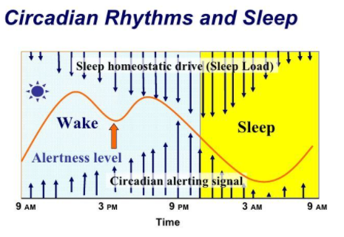

Slide 15
Car accidents as function of sleepiness
Sleepiness
Midnight
6 AM
Noon
6 PM
Midnight
Notes:
This build of slides demonstrates the similarity in the temporal distribution of meter-reading errors and auto accidents and correlates the indirect relationship that poor function has to the maximum peaks of the circadian rhythm (times of greatest sleepiness).
At the maximum peak of sleepiness (12 AM-7 AM; 1 PM-4 PM), errors and accident rates are at their highest
At the minimum troughs of sleepiness (7 AM-11 AM; and 5 PM-11 PM), function is higher and errors and accidents occur less frequently

Slide 16
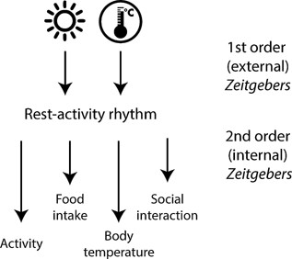
ZEITGEBERS: TIME GIVERS

Slide 17
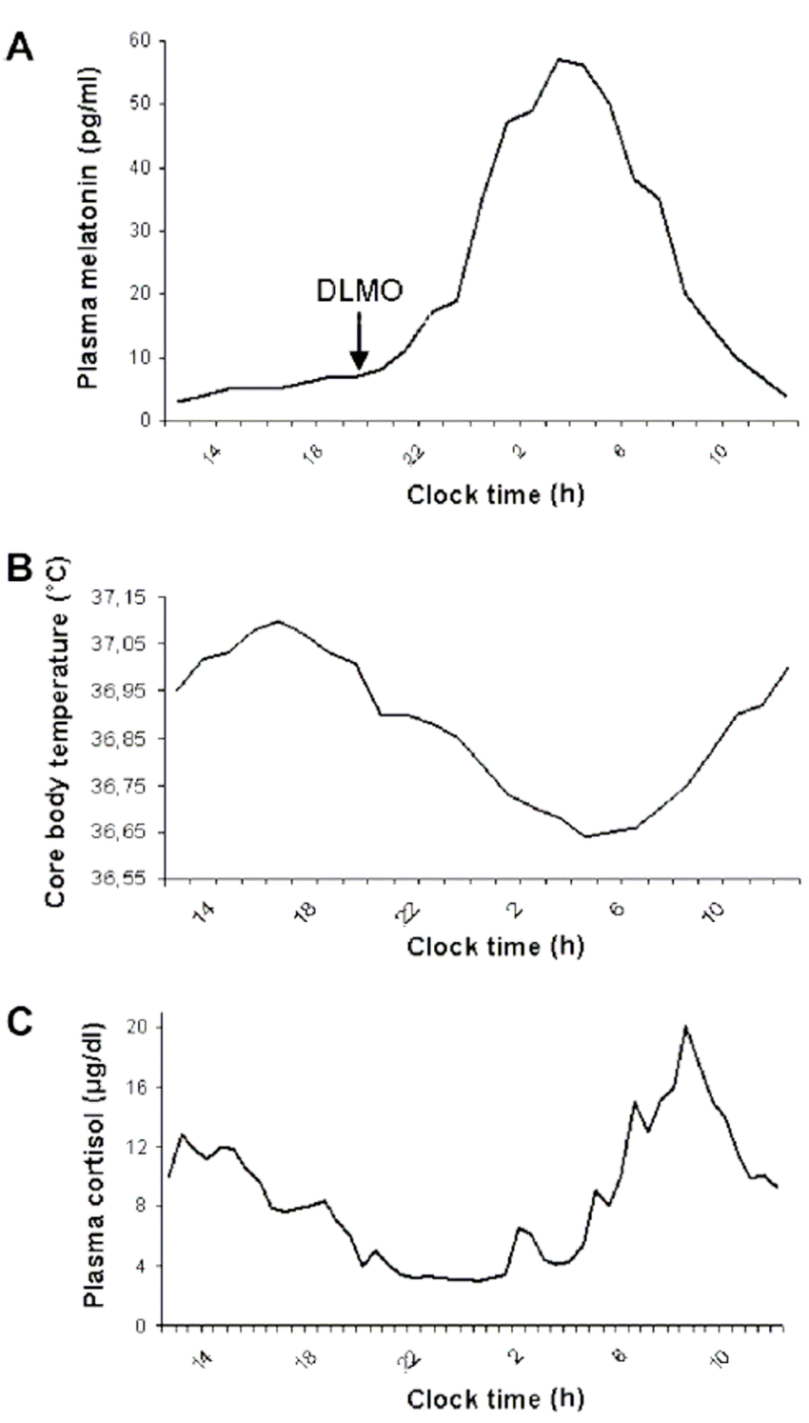
Exercise

Slide 18
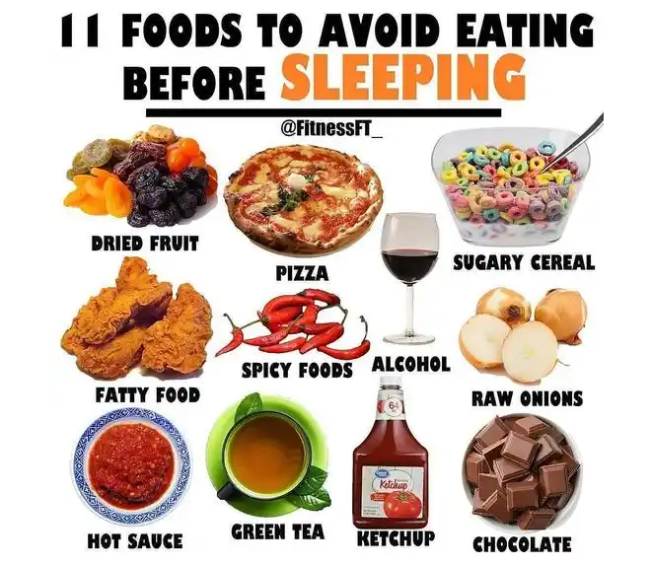
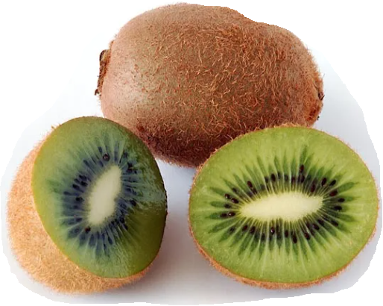
Food Intake

Slide 19
Notes:
When the total body of evidence was evaluated and when study quality, consistency, level of adversity, and magnitude of response were considered, the evidence generally supports that consumption of up to 400 mg caffeine/day in healthy adults is not associated with overt, adverse cardiovascular effects, behavioral effects, reproductive and developmental effects, acute effects, or bone status

Slide 20
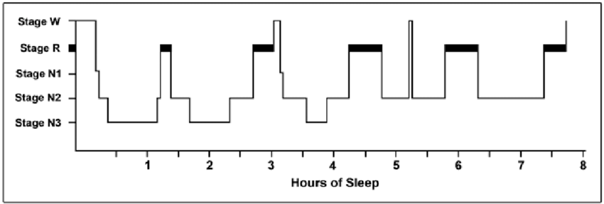
Normal Sleep
Sleep Quality = Percentage, duration, type of sleep stages
Notes:
Adapted from Berger RJ. The sleep and dream cycle. In: Kales A, ed. Sleep Physiology & Pathology: A Symposium. Philadelphia: J.B. Lippincott; 1969. Used by permission of Lippincott Williams & Wilkins.
This is a typical sleep histogram from a young/healthy adult. There are 3 findings which are important from this:
There is a 90 minute Ultradian rhythm that the body adheres to.
Note the breakdown of sleep stages.
REM sleep increases as the sleep period lengthens
There is a normal transition with few W periods interspersed
Breakdown of total time at each stage
Stage 1: 5%
Stage 2: 50%
Stages 3, 4: 20%
REM: 20%-25%

Slide 21
Sleep Before Early Morning Shift Decreased duration, stage 2, REM sleep
Wake UP!!!
Notes:
REM predominant in second half of the night
Adapted from Berger RJ. The sleep and dream cycle. In: Kales A, ed. Sleep Physiology & Pathology: A Symposium. Philadelphia: J.B. Lippincott; 1969. Used by permission of Lippincott Williams & Wilkins.
This is a typical sleep histogram from a young/healthy adult. There are 3 findings which are important from this:
There is a 90 minute Ultradian rhythm that the body adheres to.
Note the breakdown of sleep stages.
REM sleep increases as the sleep period lengthens
There is a normal transition with few W periods interspersed
Breakdown of total time at each stage
Stage 1: 5%
Stage 2: 50%
Stages 3, 4: 20%
REM: 20%-25%

Slide 22
Recovery of Self vs Recovery of Sleep
You have a life
There are things beyond just eating, reading, doing medicine and sleeping
There are people, beyond just patients, dependent on/affected by you
Participation in active recovery
Notes:
Inherent pressure built up over time that we forget who we are…

Slide 23
What do you do during your time when you are not in clinical care?
https://www.polleverywhere.com/free_text_polls/9k51oPU22kbxE03xvFPcy

Slide 24
Schedule Selection

Slide 25
Schedule Selection Pearls
Avoid too many inpatient rotations in a row
Especially in the darker months
Allow for recovery of self
Allow for transition from one sleep pattern to another
Allow for celebrating the big events (ask permission in advance)

Slide 26
Activity
Look up your Amion block schedule and identify your vulnerable months
Answer question 2
Look up important dates in your year and note them in your Fatigue Mitigation plan
Raise your hand when finished

Slide 27
Upcoming 24-Hour Call
Brief nap (10-20min) during shift at windows of opportunity (1400-1600 or 0200-0400)
Intentional caffeine (200mg-300mg) at beginning of shift
Repeat if needed 4 hours later
Discontinue caffeine intake 4-6 hours before initiating sleep

Slide 28
Short Term: Upcoming Night Shift
Prophylactic Nap 30mins – 2 hours prior to shift
Sleep Banking = extending overnight sleep by 1-3 hours the week prior to starting nights
First night may be the worst for decreased alertness
Increased risk of mistakes 0200-0400
Maintain low threshold for backup

Slide 29
Night Shift >2 weeks:
Daytime Sleep
Attempt sleep immediately after night shift
Minimize light exposure on the way home (sunglasses)
Optimize environment (light-blocking shades, ear plugs, eye mask)
Anchor sleep: 4-5 hours (Recommended everyday even off days)
Additional sleep period 2-3 hours (later in the day, times may be irregular)
Consider a compromised-phase delay
Bright light therapy (10,000 Lux) ~15mins q1h during first half of night shift, then melatonin 3-5mg 30-60mins prior to bedtime
Maintain schedule on off days with late sleep schedule on days off (3-4am bedtime)

Slide 30
Post-24 hr shift (Work next AM)
Eat a light meal, avoid excessive liquids
Attempt sleep immediately after night shift
Optimize environment (light-blocking shades, ear plugs, eye mask)
Consider two 90-minute naps during the day (upon getting home and again around 1400-1500)
Consolidated daytime sleep may result in the following negative consequences:
Increased arousals due to circadian rhythm
Sleep inertia if waking up around 1400-1500
Decreased sleep pressure to sleep overnight

Slide 31
Shifting Sleep Schedule
Bright light therapy (10,000 Lux) ~15mins q1h during first half of night shift
Consider melatonin 3-5mg 30-60mins prior to desired bedtime in morning if difficulty falling asleep
Do this only when you get back home
10,000 Lux light box on Amazon in $30-50 price range
Maintain late sleep schedule on days off (3-4am bedtime)

Slide 32
Fatigue
Anemia
Heart Disease
Medications
Depression
Anxiety
Boredom
Exhaustion/Overuse
Notes:
Ask the trainees: When was the last time you went to your PCM?

Slide 33
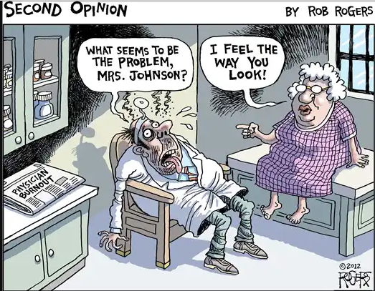

Slide 34
Notes:
https://www.gabekwakyi.com/essays/work-burnout-symptoms

Slide 35
Burnout Amongst Residents Across Multiple Specialties
Meta-analysis from 2018
Higher in surgical subspecialties
Higher in emergent care settings
Pediatrics: ~30%
Notes:
Rodrigues H, Cobucci R, Oliveira A, Cabral JV, Medeiros L, et al. (2018) Burnout syndrome among medical residents: A systematic review and meta-analysis. PLOS ONE 13(11): e0206840. https://doi.org/10.1371/journal.pone.0206840
https://journals.plos.org/plosone/article?id=10.1371/journal.pone.0206840

Slide 36
What actions will you do to prevent burnout, restore you?
https://www.polleverywhere.com/free_text_polls/9k51oPU22kbxE03xvFPcy

Slide 37
How can we change our culture?

Slide 38
Arora-isms For Burnout
Know yourself: understand who you are outside of medicine
Compare time spent on free/non-clinical time vs those spent on your prioritized values
Schedule your free time
Prioritize physical/mental health over accolades
Give time to those you love
Understand the margins of your day
Prioritize your sleep – maintain consistency

Slide 39
Questions?
If you ever have any concerns about your sleep or want to discuss concerns for a sleep disorder, reach out to me via text: 301-404-9046 or e-mail (new e-mail forthcoming)

Slide 40
Back Up Slides

Slide 41
2B Alert scenarios

Slide 42
NICU nights: 7 hrs sleep during day + 100 mg caffeine just past midnight
Notes:
0.06% blood alcohol level = 3 alcoholic drinks over an hour in 150 lb man. Impaired judgement and reaction time affected significantly.

Slide 43
NICU nights: 8 hrs sleep + 100 mg caffeine at 2200

Slide 44
Dangerous time frame: 0100-0700
Notes:
Dangerous timeframe: This is the time frame where the alertness can be significantly impaired.

Slide 45
Optimal caffeine timing: 2 B Alert
Notes:
Big cup = 200 mg coffee at 0200, little cup = 100 mg coffee at 0400.

Slide 46
ED scenario
Inputs
Sleep Schedule |  |  |  | Caffeine Schedule |  |  | Peak Alertness Schedule
Start |  | End |  |  |  |  | Start |  | End
Day | Time | Day | Time | Day | Time | Dose (mg) | Day | Time | Day | Time
0 | 22:00 | 1 | 06:00 |  |  |  | 1 | 08:00 | 1 | 18:00
1 | 22:00 | 2 | 06:00 |  |  |  | 2 | 10:00 | 2 | 20:00
2 | 23:00 | 3 | 07:00 |  |  |  | 3 | 12:00 | 3 | 22:00
4 | 00:30 | 4 | 08:00 |  |  |  | 4 | 14:00 | 5 | 00:30
5 | 02:00 | 5 | 10:00 |  |  |  | 5 | 18:00 | 6 | 06:00

Slide 47
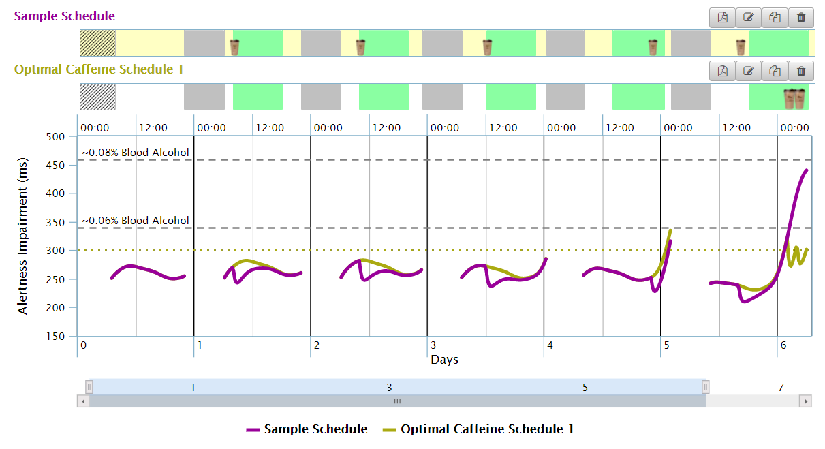
ED schedule, progressive 2 hr delayed shift, overnight on Day 6

