Slide 1
POC IN S1 TO VALIDATED YOUR LES AND SRB
NAME PHONE EMAIL
Mr. Otey, James 400-3912 james.j.otey.civ@mail.mil
Mr. Duggan Brandon 319-2639 brandon.s.duggan.civ@mail.mil
Mr. Burgamy, Scott 400-1460 scott.r.Burgamy.civ@mail.mil
SPC Adjei, Kwaku 295-4501 kwaku.adjei.mil@mail.mil
SPC Alvarado, Alma 319-2645 alma.d.alvarado2.mil@mail.mil
Ms. Facey, Marla 400-3332 marla.d.facey.civ@mail.mil
Ms. Rafaela Ramos 319-2643
rafaela.m.ramos-Santos.civ@mail.mil

Slide 6
SM will do review one at a time

Slide 7
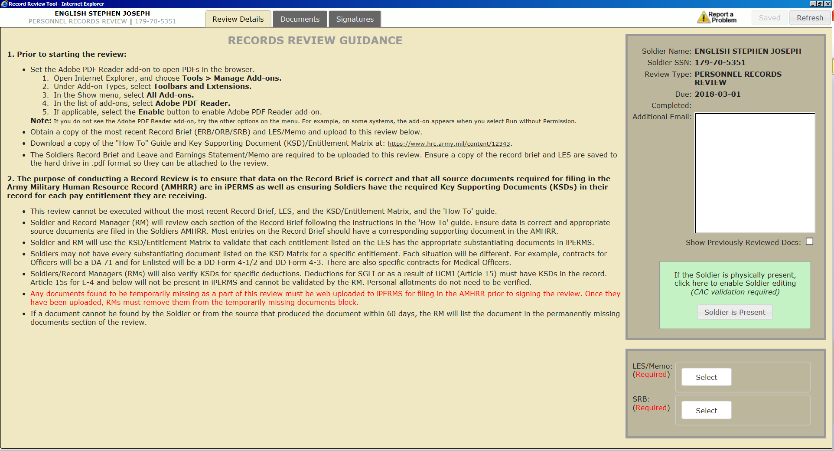
MOST UPLOAD SRB/LES BEFORE YOU CAN DO THE RECORD REVIEW. THEY CAN GET THEIR SRB FROM
https://www.ipps-a.army.mil/you-and-ipps-a/soldiers/

Slide 8
Refer to slide 1 to have someone validate your LES and ORB/ERB

Slide 9
Click on each individual document to verify

Slide 10
After reviewing each document
Soldier Reviewed boxes will be checked off
Next Click Signature
tab

Slide 12
Click inside box to sign

Slide 14
Once review is completed return to this page to Logout
Personnel Record Review is now complete. The
Review Manager (S1) will sign and close out the Reviews

Slide 15
Again contact S1 for a Reviewing Manager to finish your Records Review.

