Slide 1
MEDPROS Get to Green
Readiness Category | Location | Get to Green
DRC4 (Annual Dental Exam) | Primary Care Dentistry: Building 7, 2nd floor, Room 2413 Hours: M-F 0730-1530 | Appointments can be scheduled by calling 301-295-5411.
PHA (Periodic Health Assessment) | Medical readiness Clinic: Building 7, 2nd floor, Room 2100 Hours: M-F 0730-1600 | Part 1 (Online): AKO > Self Service > My Medical > My Medical Readiness > Periodic Health Assessment > New Form Part 2 (In-person): Must be within 30 days of Part 1. Those in WRNMMC can be scheduled by -Intranet web site: https://apps2.capmed.mil/EventSignUp/ -Phone: Direct clinic phone 301 295 5483/Central scheduling 301 295 5411 or 301 319 6591
HIV (Human Immunodeficiency Virus test) | Labs: Building 19, 1st floor OR Building 9, 2nd floor Hours: M-F 0700-1800 | Appointments can be scheduled by calling (301)319-3420. Walk-in appointments also available from 0700 – 1800.
DNA (Deoxyribonucleic acid blood draw) | Labs: Building 19, 1st floor OR Building 9, 2nd floor Hours: M-F 0700-1800 | Appointments can be scheduled by calling (301)319-3420. Walk-in appointments also available from 0700 – 1800.
IMM (Immunizations) | Immunizations Clinic: Building 19, 4th floor, Room 4204 Hours: M-F 0730-1600 | Appointments can be scheduled by calling (301)319-3420. Walk-in appointments also available from 0730 – 1600. Proof of vaccines can be sent via email to: dha.bethesda.j-11.mbx.proof-of-vaccine@mail.mil
HRC4 (Hearing) | Medical Readiness Clinic: Building 7, 2nd floor, Room 2220 Hours: M-F 0700-1500 | Appointments can be scheduled by calling (301) 400-0072 / (301) 400-2891
VRC4 (Vision) | Optometry Clinic: Building 85T, 1st floor Hours: M-F 0700-1600 | Appointments can be scheduled by calling (301)295-1339
Building #19: America / Building #7: Liberty / Building #9: Arrowhead
POC: SSG Michael Cruz michael.a.cruz54.mil@mail.mil As of: 2FEB2022

Slide 2
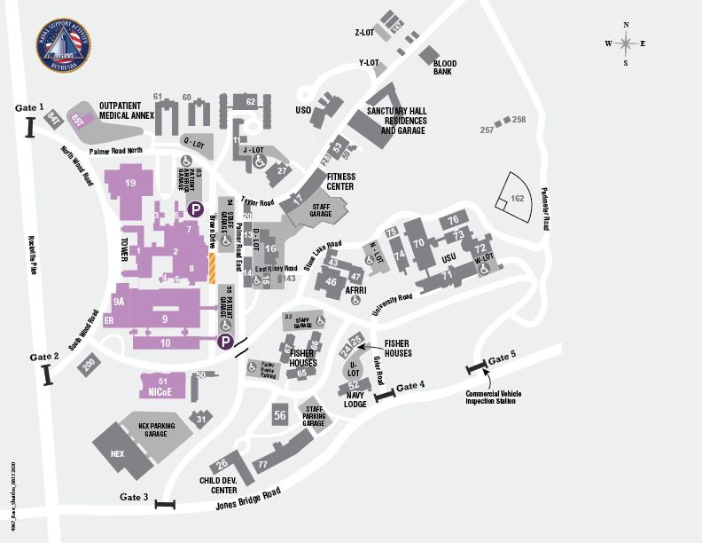
MAP FOR MEDPROS LOCATIONS. Current as of 05 APR 2021
Legend
PHA
Dental
Hearing
HIV
DNA Immunizations
Vision (Building 14 is HHC Ops. Only if you DO NOT wear glasses/contacts)

Slide 3
MANDATORY TRAINING DELINQUENCY
TRAINING Category | Location/website and class #
SHARP | SHARP Face to Face SSG Ghant, Aarynne SHARP/SAPR Victim Advocate Troop Command-WRNMMC Govt Cell: 240-274-1856 Office: 301-319-0262 aarynne.c.ghant.mil@mail.mil To sign up for training please email: dha.bethesda.j-11.mbx.sharp@mail.mil | MS TEAMS, DATES AND TIMES: As of 01 OCTOBER 2021 SHARP training is now broken up into 5 modules. Each module is about an hour in length. Below are the next Complete Trainings Face to Face dates: -11 Feb 22 in Memorial auditorium at 0900 to 1500 -25 Feb 22 Memorial auditorium at 0900 to 1500 -11 Mar 22 Memorial auditorium at 0900 to 1500 Below are the Virtual Telephonic training dates( 1-2 modules at a time): -27 Jan 22 0600/1900 Module 4 WEBSITE: https://www.wrnmmc.intranet.capmed.mil/USArmyTroopCommand/sharp/SitePages/Home.aspx
EO SFC Slaughter, Milika Tel: (301)295-2269 | Virtual EO Training Provided by Region EOA: 1st Tuesday of the month at 1000 1st Thursday of the month at 1200 3rd Tuesday of the month at 2000 3rd Thursday of the month at 1200 Virtual link: https://conference.apps.mil/webconf/pyongkuxwsezvxtoktegnwi998uvyc04 Web Conf Dial In Number: 410-874-6300 or DSN: 312-874-6300 Web Conf PIN: 230565893 | EO Face-to-Face training (reserved through HEAT) occurs on the 1st and 3rd Friday of every month at 0800 in Memorial Auditorium.
AT LEVEL 1 | https:/jkodirect.jten.mil/ Course No. JS-US007
EPRC (Every 3 years only) | https:/jkodirect.jten.mil/ Course No. DMRTI –US001, -US011, -US017, -US018 *Select course that best fits your occupation.
HIPAA | https:/jkodirect.jten.mil/ Course No. DHA –US001
Get To Green
Phase II Students: Submit certificates to your Instructor | Interns/Residents: Submit to SFC Harden (CC SSG CRUZ!) (Vanessa.d.harden.mil@mail.mil / CC:michael.a.cruz54.mil@mail.mil) | Everyone Else: Submit to your Department’s DTMS writer

Slide 4
MANDATORY TRAINING DELINQUENCY
TRAINING Category | Location/website and class # | Get to Green
SGLI | https://milconnect.dmdc.osd.mil/milconnect | Print / Save Certificate. MEDPROS will update automatically.
OPSEC | https://www.lms.army.mil/ (Army OPSEC Level 1) OR https:/jkodirect.jten.mil/ (Joint Staff Operations Security) | PHASE II STUDENTS: Submit Certificates to Instructor INTERNS / RESIDENTS: Submit certificates to SFC Harden vanessa.d.harden.mil@mail.mil EVERYONE ELSE: Submit certificates to your Department’s DTMS writer
TARP | https://www.lms.army.mil *It may take 24-48 hours for your class to load
Information Security Program Training | https://www.lms.army.mil *It may take 24-48 hours for your class to load
Cyber Awareness Challenge | https://jkodirect.jten.mil/html/COI.xhtml?course_prefix=DOD&course_number=-US1364-22 Course No. DOD –US1364-22
Employee Safety (E4 and Below) (One time training) | https://www.lms.army.mil *It may take 24-48 hours for your class to load
Composite Risk Management (All personnel) (One time training) | the training is completed on ALMS, but you must register in ATRRS. Go to https://www.atrrs.army.mil/atrrscc/ , Search for Risk Management and register for the Risk Management Basic Course.
Supervisor Safety (E5 and above) (One time training) | All E5 and above need to complete: https://safety.army.mil/TRAINING-COURSES/Online-Training *Please follow enrollment instructions listed on website

Slide 5
MANDATORY TRAINING DELINQUENCY
TRAINING Category | Location/website and class # | Get to Green
Personal Readiness (Replaced Suicide Prevention and ASAP training. Course TBD) | FY22 Quarter 2 Dates (online via A365 Teams. Right Click>Open Hyperlink) -22 FEB 2022 @ 1330 -22 MARCH 2022 @ 1330 Training coordinators can contact ASAP to schedule unit level training to accommodate alternate work schedules. POC is the Army Substance Abuse Program: jillian.d.farrow.civ@army.mil(301) 400-1087 | PHASE II STUDENTS: Submit Certificates/Roster to Instructor INTERNS / RESIDENTS: Submit certificates/Roster to SFC Harden vanessa.d.harden.mil@mail.mil EVERYONE ELSE: Submit certificates to your Department’s DTMS writer
DD93 | https://www.esd.whs.mil/Portals/54/Documents/DD/forms/dd/dd0093.pdf DD93 must be completed in person/face to face at S1 | Complete form, schedule appointment with and submit to: Ms. Nicole A. Himes nicole.a.himes.civ@mail.mil Office: 301-319-2644
Personal Record Review (PRR) | https://iperms.hrc.army.mil/rms/ | The Review Manager (S1) will sign and close out the reviews. Contact Ms. Himes for questions/concerns. Ms. Nicole A. Himes nicole.a.himes.civ@mail.mil Office: 301-319-2644
Controlled Unclassified Information (CUI) | https://securityhub.usalearning.gov/index.html OR https://www.dodcui.mil/Home/Training DTMS Code: MC – 00576 | SEE BLOCK 2
Winter Safety Training (WRNMMC) | Homepage: https://www.wrnmmc.intranet.capmed.mil/SitePages/home.aspx Direct Link to Training: https://apps2.capmed.mil/OnLineTraining | No submission needed. *HOSPITAL STAFF ONLY*
Travel Card 101, DTS 101, SoU, GTCC Application Process | Please reference slides 9-16 for instructions on how to: In-processing DTS Complete Travel 101 Complete the Statement of Understanding Apply for a GTCC | SEE BLOCK 2

Slide 6
Sick Call Procedures
Internal Medicine
BLDG 19, 2nd Floor, check in at front desk
Must arrive in OCP w/ CAC in hand
Hours: 0600-0700
Emergency Room (after hours)
BLDG 9, 1st Floor
Check in at desk w/ CAC in hand

Slide 7
UNCLASS/FOUO
NSAB Community POCs
Military Family Life Counseling (MFLC)
Mr. Stephane Yambaka
Ms. Tonya Pleasant
WRNMMC/NSAB Resiliency
Ms. Shantrell Calvy-Holloman
Army Community Services
Mr. Rodger Knepper
Military Family Support Center
Mr. Robert Ford
Red Cross
Ms. Kristen Farren
Family Advocacy Program
Ms. Danielle Birx-Raybuck
MWR/NAF
Ms. Anna Rhodes
Army SHARP
SSG Aarynne Ghant
Navy SARP/MFSC
Ms. Marlo Brooks
Duty Chaplain
(301) 366-2824
United Service Organization (USO)
Ms. Midge Matlock-Williams
Ms. Karen Armstrong

Slide 8
DTMS TRAINING CODES (FOR SECTION DTMS MANAGERS)
*Input training using the codes below. Failure to use these specific codes will result in inaccurate/outdated training record data in the Master Tracker. DTMS training reports are pulled weekly using these codes only.
TRAINING REQUIREMENT | TASK NUMBER
SEXUAL HARRASSMENT, ASSAULT, RESPONSE, PREVENTION (SHARP) | 150S-SHA-0100
ANTI-TERRORISM (AT) TRAINING | DA-CMT01
THREAT AWARENESS & REPORTING PROGRAM (TARP) | DA-CMT02
EPRC | DA-CMT07
EQUAL OPPORTUNITY (EO) | DA-CMT10
MRT | DA-CMT12
PERSONAL READINESS (ASAP + SUICIDE. FACE TO FACE/TEAMS) | DA-CMT15
OPERATIONS SECURITY (OPSEC) | DA-CMT16
INFORMATION SECURITY (INFOSEC) | DA-CMT18
INFORMATION AWARENESS TRAINING (CYBER AWARENESS) | DA-CMT19
SUPERVISOR SAFETY TRAINING | MC - 00013
EMPLOYEEE SAFETY TRAINING | MC - 00014
COMPOSITE RISK SAFETY | MC - 00016
HIPAA | MC - 00020
CUI | MC - 00576

Slide 9
TC-WRNMMC Defense Travel System (DTS)/Government Travel Card In-Processing
The following training certificates and documents must be provided to in-process
TC-WRNMMC DTS and GOVCC:
1. DTS (BASIC) – DTS TRAVEL DOCUMENTS (DTS 101)
2. PROGRAMS & POLICIES – TDY TRAVEL POLICIES 101
3. PROGRAMS & POLICIES – TRAVEL CARD PROGRAM (TR AVEL CARD 101) [MANDATORY] {MUST BE TAKEN EVERY 3 YEARS}
4. GTCC SOU (Statement of Understanding)
DTS Trainings
For items 1-3 listed above the training website is
https://secure.defensetravel.dod.mil/neoaccess/login.php
If you have taken any of the courses listed above they should be listed on the training website in your list of completed courses.
If you do not have a DTS Account
Sign into DTS at www.defensetravel.osd.mil and self-register. Complete all information and ensure it is accurate.
For organization selected the following:
Force: US ARMY
State: District of Columbia
Site ID: Washington
Unit: TC-WRNMMC
SOU
The SOU can be found at the following link:
https://www.esd.whs.mil/Portals/54/Documents/DD/forms/dd/dd3120.pdf
Add “Ian Kang 301-319-2509” as the GTCC Agency Program Coordinator (APC). You and your supervisor (not APC) must sign the form.
Citi Website:
Citi manager account can be found at the following link:
https://home.cards.citidirect.com/CommercialCard/login
Send all 4 documents to your perspective company orderly room and “CC” the
BDE DTS rep at ian.w.kang.mil@mail.mil. Once done (by your company), you can
come get a signature for your in-processing checklist.
Once your DTS profile and GTCC account is assigned to TC-WRNMMC (not
WRNMMC), you are responsible for ensuring your DTS profile and GTCC account
have your current address, phone number and EFT information. If you do not,
YOUR CARD WILL GET DECLINED REGARDLESS OF ACTIVATION STATUS.

Slide 10
Government Travel Charge Card (GTCC) Guide

Slide 11
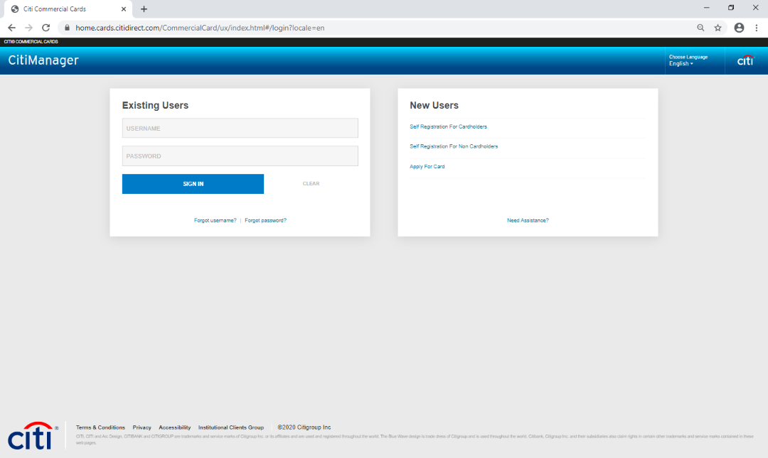
To apply for a Government Travel Charge Card (GTCC) visit the CitiManager site www.citimanager.com/login
Click on Apply For Card

Slide 12
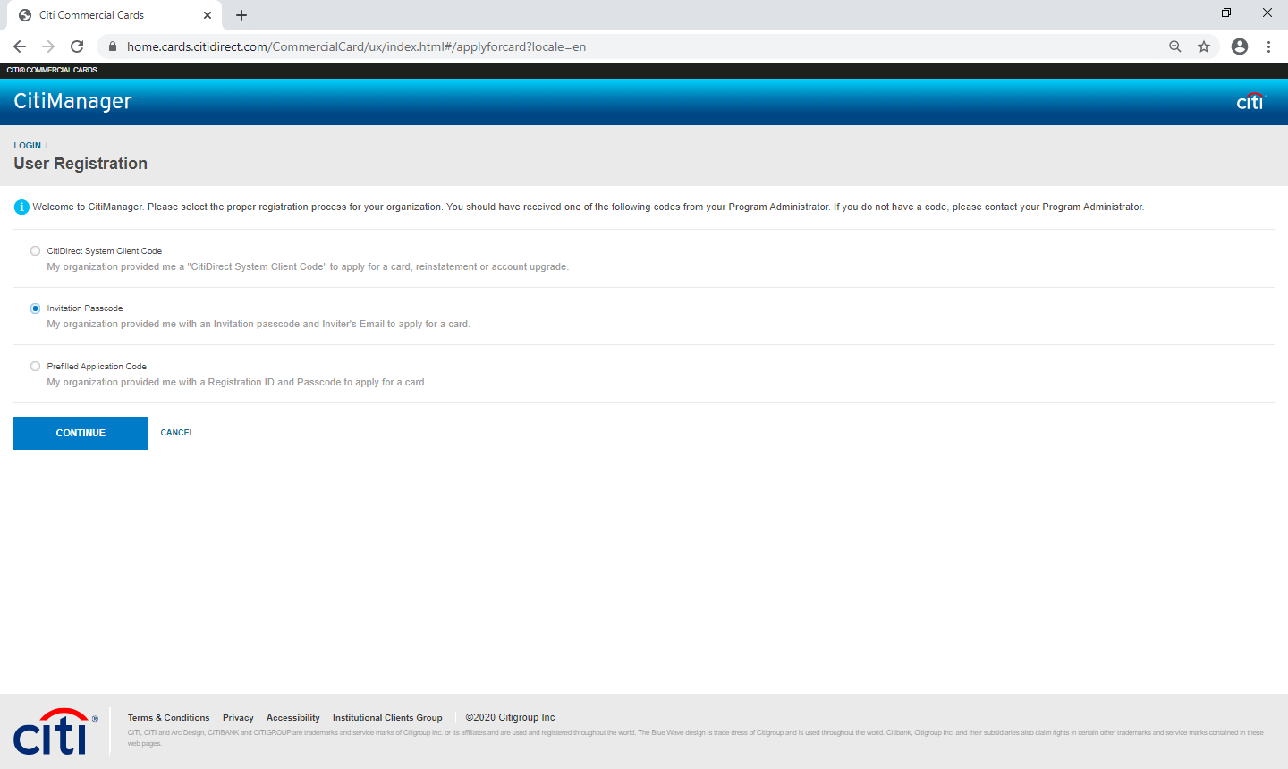
Select Invitation Pass Code then click Continue

Slide 13
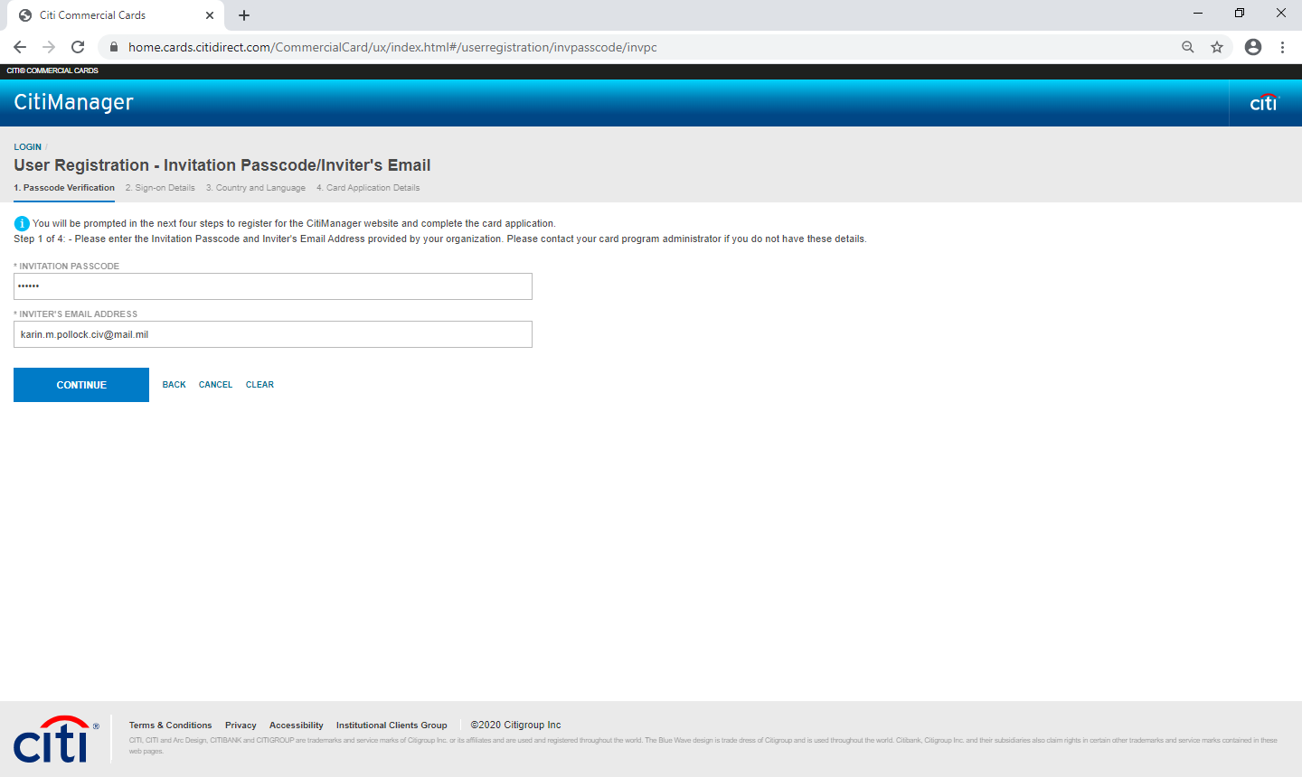
The Invitation Passcode is
0040248
The Inviter’s Email Address is
ian.w.kang.mil@mail.mil
Click Continue

Slide 14
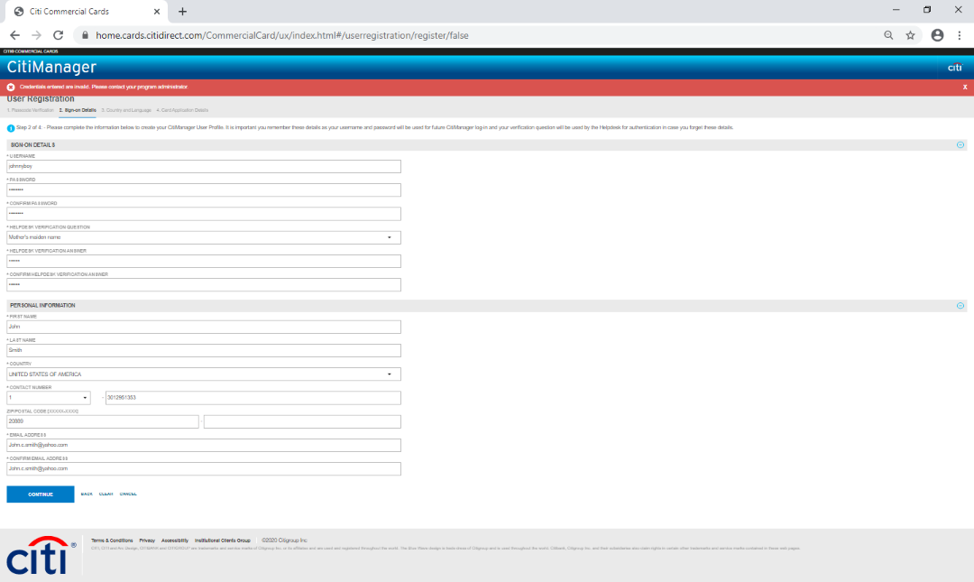
Fill in all required blanks
Click continue

Slide 15
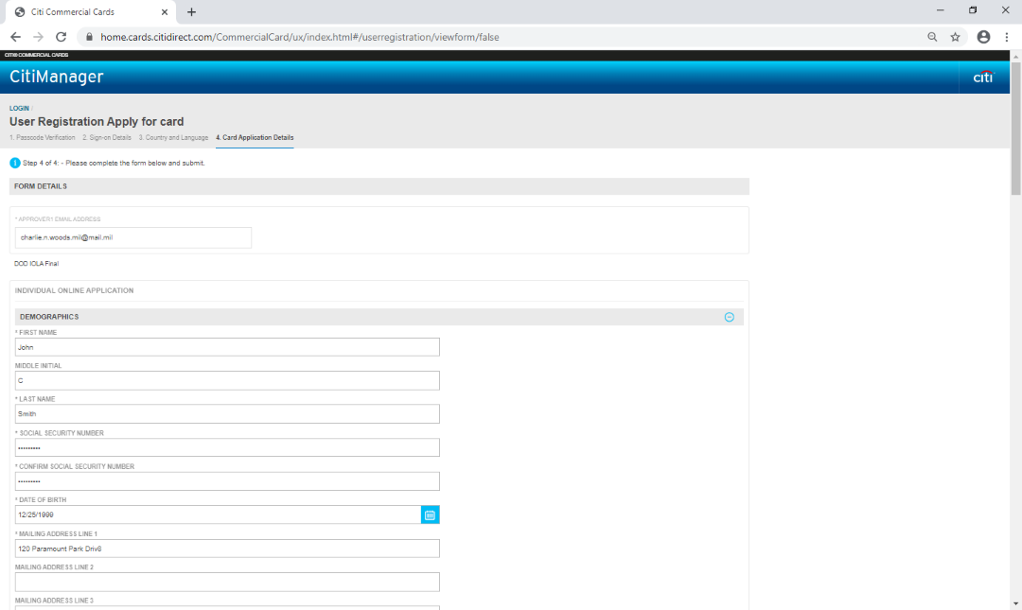
APPROVER 1 EMAIL ADDRESS
Enter your supervisor’s email address,
NOT SSG Kang’s. IT WILL AUTOMATICALLY COME TO ME (SSG KANG) ONCE YOUR SUPERVISOR APPROVES.
Fill in all required blanks

Slide 16
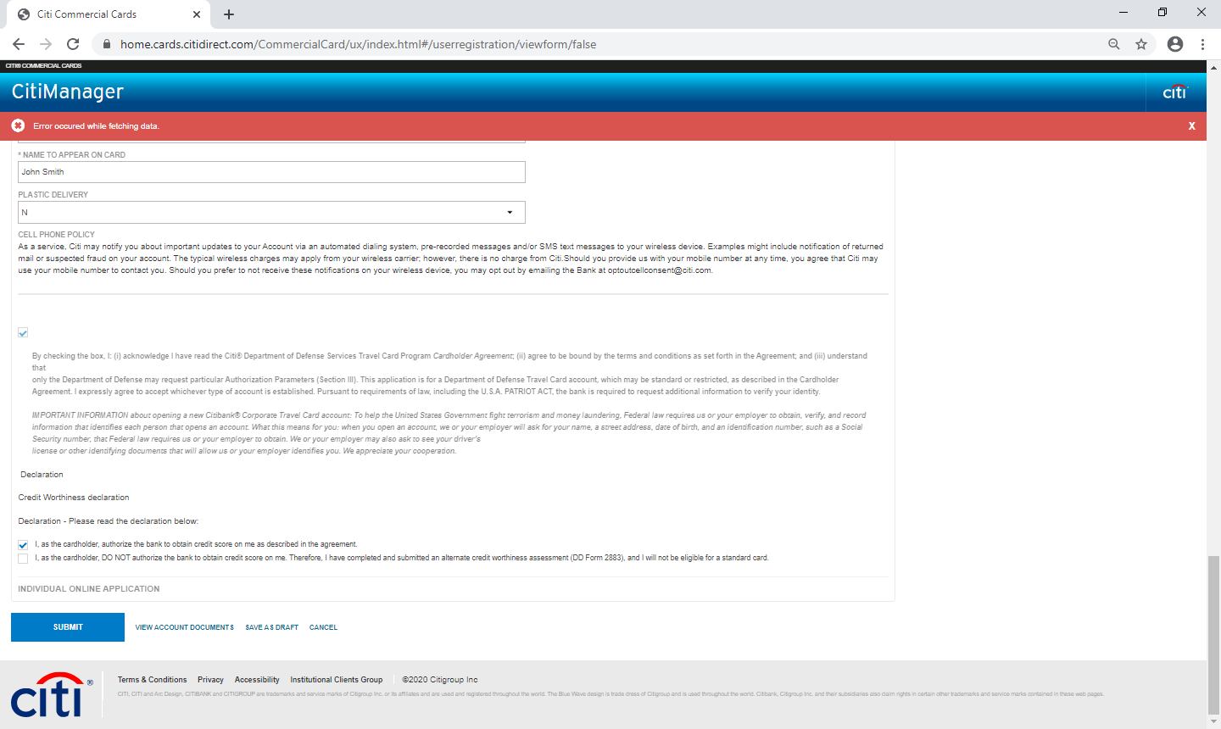
Fill in required blanks and check appropriate boxes
You must upload your SoU and GTCC training certificate by clicking on View Account Documents on bottom of page
Click Submit when complete

Slide 17
PRR Instructions

Slide 18
Access iPERMS (use authentication certificate):
https://iperms.hrc.army.mil

Slide 19
Lil X
�...L.:.:::c::'....-==========::::,-�---------------------------------------------� ii_c�I �I ^{S_ea_rc_h.._.} P�� I G *@ "
UNCLASSIFIED//FOR OFFICIAL USE ONLY
��l.PERMS
Primary Records Center
DoD Approved Certificate Login:
Need help with CAC login?
Please contact your local DEERS office
Login to iPERMS with your GAG or other
----v> CERTIFICATE LOGIN
DoD approved certificate
Don't have a CAC or access to a CAC enabled computer?
Log in to the HRC Portal using your OS Logon at www.hrcapps.army.mil/portal/
View the HRC Portal Login guide at: www.hrc.army.mil/assetl18300
Problems accessing iPERMS?
Please contact support at 502�08-0217
2.4.0.1
reaturelintegration I 2b599f2 2021-07-02 @ 16: 15 EDT
RMA_01-2
UNCLASSIFIED//FOR OFFICIAL USE ONLY

Slide 23
Access LES: https://mypay.dfas.mil
*Ensure LES is current and has entitlements listed*
Access SRB (Officers and Enlisted): https://myerb.ahrs.army.mil or
ORB (Officers only): https://aim.hrc.army.mil
**The SRB/ORB and LES must be uploaded before you can proceed to the documents tab**

Slide 24
Review each document and make a selection from the “DD 93 Reviewed” drop-down menu.
If necessary, provide comments for the record manager in the “Soldier Comments” section (e.g. AWD DOC, effective 2021-01-22, is misfiled).

Slide 25
POC in S1 to verify your LES and SRB/ORB
NAME
Ms. Himes, Nicole SGT Salsedo, Whitney PFC Friedel, Elizabeth PFC Preece, Gage
EMAIL
nicole.a.himes.civ@mail.mil whitney.m.salsedosanchez.mil@mail.mil elizabeth.m.friedel2.mil@mail.mil gage.j.preece.mil@mail.mil
You will NOT be able to sign your review until your LES and SRB/ORB have been verified. Contact one of the POCs above, or your company POC, when your documents are ready to be verified.

Slide 26
Once your LES and SRB/ORB have been verified by a record manager, the option to sign your review will populate.

Slide 27
If you have temporarily missing documents and have provided them to your record manager for upload to iPERMS, select “NO” and sign the review.
Normal (non-board) iPERMS uploads can take between 4-8 weeks for batch completion.

Slide 31
Once your signature is accepted and you receive this message, your portion of the review is complete.
The record manager will be notified (via automatic email) that your review has been signed and will close out the remainder of your review.

